Slide 1


Completing the Connection
Team Aggies+1: Olivier Beya, Ashana Evans, Max Ellsberry, Brandon Long, Shanel Smith

Slide 2

Have you ever…
missed an opportunity because you forgot to communicate?
needed a means to organize networking information?
wished you had a reminder to touch base with an old friend?

Slide 3


~7 Hours
Spent at a career fair, speaking to companies and schools over a two day period.
~ 8 Companies
Estimated number of companies students speak with during the four hour time period
~433 million
Registered users of the online networking site LinkedIn w/ two new members every second
1
Opportunity

Slide 4

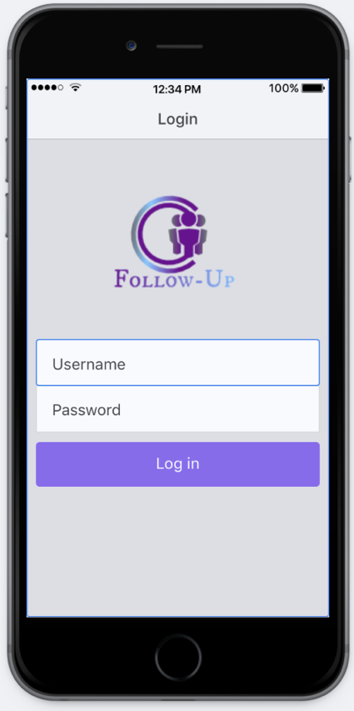
Cross-platform mobile application that allows users to sustain connections and produce future opportunities.
2
Solution

Slide 5


Google Firebase
Ionic Framework
Angular.JS
Technologies Used

Slide 6

In-App Search Feature
Image Processing / Pattern Recognition
3
What’s Next?

Slide 7

Thank You

